Slide 1
Conditional & Flowchart
Praktikum Algoritma dan Pemrograman
Dosen Pengampu :
Rofiq Cahyo Prayogo, S. T, M. T
Fitra Adi Kusuma(40040326630059)
Teknologi Rekayasa Otomasi
Departemen Teknologi Industri
Sekolah Vokasi
Universitas Diponegoro

Slide 2
Alur Pembelajaran
Pengertian
Boolean
Logika and, or, not
Logika If else
Flowchart
Pembuatan proyek
Demo program

Slide 3
Kondisi
Perintah yang akan berjalan ketika suatu nilai terpenuhi maupun tidak terpenuhi

Slide 4
Boolean
Tipe data yang hanya memiliki dua nilai mungkin yaitu true
(benar) dan false (salah). Digunakan untuk mengendalikan flow dan keputusan
dalam program.

Slide 5
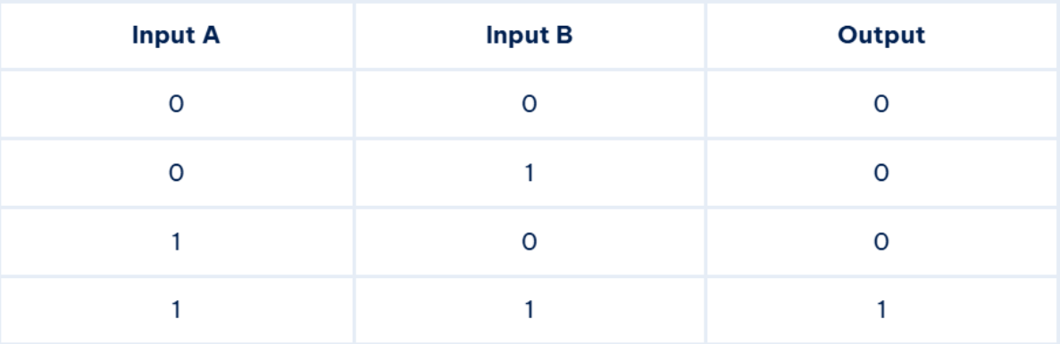
Logika AND
Kedua kondisi terpenuhi
1 = TRUE
0 = FALSE

Slide 6
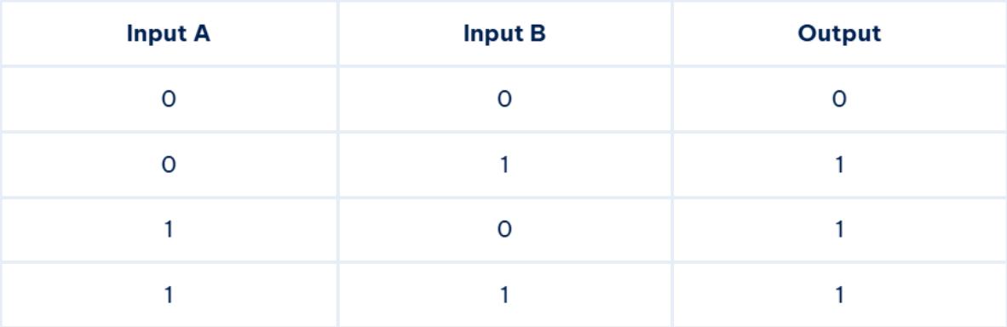
Logika OR
Salah satu kondisi yang terpenuhi akan menghasilkan nilai true
1 = TRUE
0 = FALSE

Slide 7
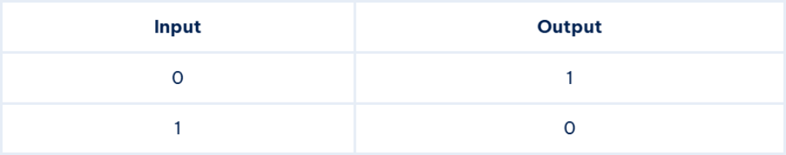
Logika NOT
1 = TRUE
0 = FALSE
Kebalikan nilai Boolean yag diberikan

Slide 8
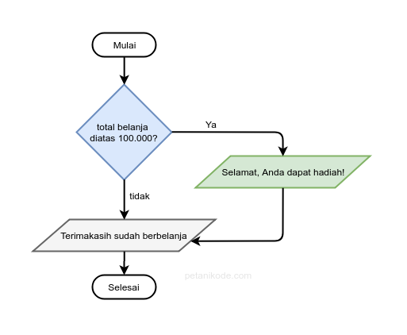
Percabangan IF
Percabangan if digunakan saat terdapat satu pilihan keputusan.

Slide 9
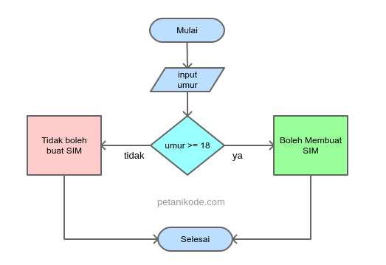
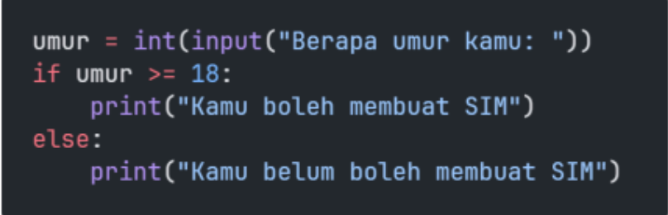
Percabangan IF/ELSE
Percabangan if else digunakan saat terdapat dua pilihan keputusan.

Slide 10
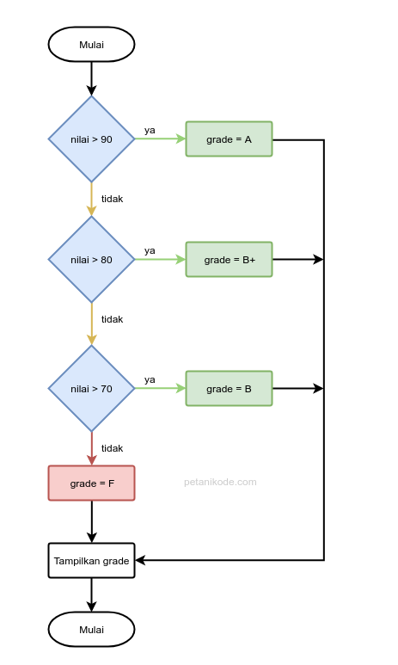
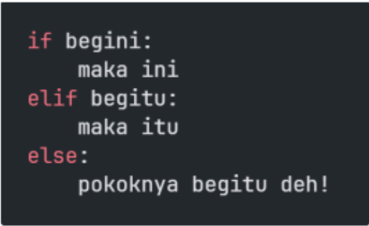
Percabangan IF/ELSE IF/ ELSE
Percabangan if/elif/else digunakan saat terdapat lebih dari dua pilihan keputusan.

Slide 11
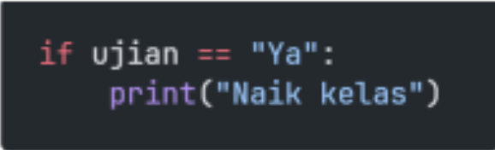
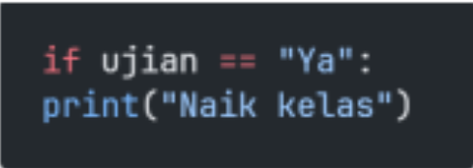
Aturan Penulisan Percabangan
Penulisan yang benar Penulisan blok if harus diberikan indentasi tab atau spasi 2x. | Penulisan yang salah Tanpa indentasi/spasi/tab

Slide 12
Flowchart
Diagram yang menampilkan langkah-langkah dan keputusan untuk
melakukan sebuah proses dari suatu program.

Slide 13
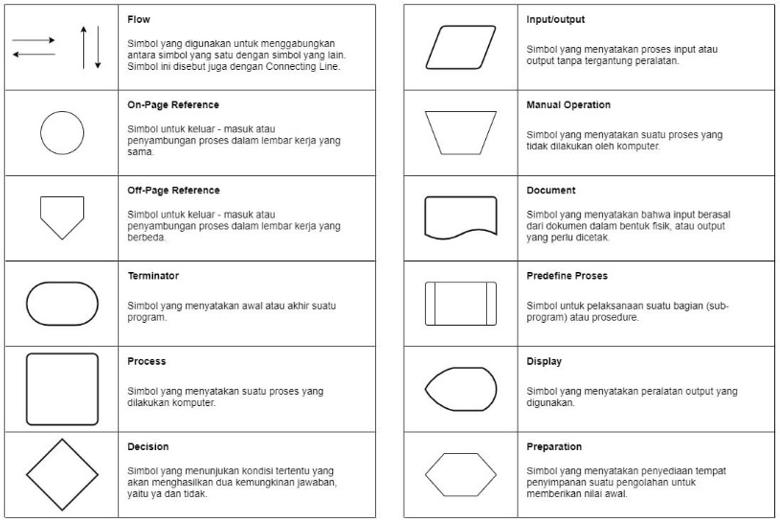
Simbol Flowchart

Slide 14
Project
User diminta masukan untuk memilih negara dan memasukkan usia, kemudian ada beberapa kondisi untuk mengemudi dibeberapa negara tersebut:
Afrika Selatan (Jika umur >= 17: boleh mengemudi)
Prancis (Jika umur >= 15: boleh mengemudi dengan pengawasan orang tua, jika >= 18: boleh mengemudi)
Mexico (Jika umur >= 15: boleh mengemudi dengan didampingi orang tua, jika >= 16: boleh mengemudi dengan izin orang tua, jika >= 18: boleh mengemudi)
Indonesia (Jika umur >= 17: boleh mengemudi)
Kemudian cetak dari hasil kondisi

Slide 15
Tipe Data
Jenis Data. di pyhton=String, Integer, Float, Boolean, dll

Slide 16
Tipe Data yang Umum Digunakan
1.TIPE DATA INTEGER
Tipe integer menyatakan nilai berupa bilangan bulat
(tanpa koma).
Contoh: 10, -5, 2025
2.TIPE DATA FLOAT
Tipe float menyatakan nilai berupa bilangan desimal (ada
koma).
Contoh: 3.14, -2.5, 0.001
3.TIPE DATA STRING
Tipe string menyatakan teks, ditulis di antara tanda kutip
" " atau ' '.
Contoh: "Hello",'Python'
4.TIPE DATA BOOLEAN
Tipe boolean hanya bernilai True atau False.
Contoh: True, False
5.TIPE DATA LIST
Tipe list menyimpan kumpulan data yang bisa diubah
(mutable).
Contoh: [1, 2, 3], ["a","b","c"]
6.TIPE DATA TUPLE
Tipe tuple mirip list, tapi isinya tidak bisa diubah
(immutable).
Contoh: (1, 2, 3)
7.TIPE DATA DICTIONARY
Tipe dictionary menyimpan data dalam bentuk pasangan
key → value.
Contoh: {"nama": “asal","usia": 17}
8.TIPE DATA SET
Tipe set menyimpan kumpulan data unik (tidak boleh ada
duplikat).
Contoh: {1, 2, 3, 4}

Slide 17
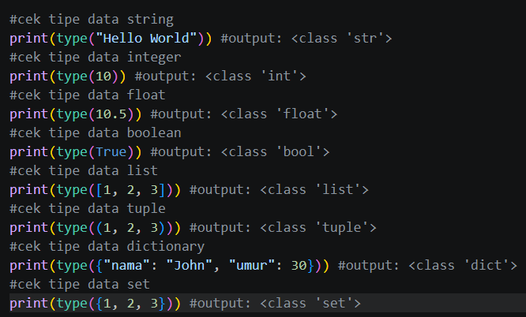
Cek Tipe Data
Menggunakan Fungsi type()

Slide 18
Oprasi
Memanipulasi data

Slide 19
Variabel
Algoritma
Pemrograman
Otak atau logika di balik sebuah program, tanpa algoritma program yang dibuat akan tidak efisien, salah, atau nahkan tidak bisa berjalan
proses menerjemahkan algoritma tersebut ke dalam bahasa yang dapat dipahami dan dijalankan oleh computer. Tanpa pemrograman, algoritma akan menjadi konsep di atas kertas

Slide 20



Tools/Shoftware

Slide 21
Technology Infographics
Jupiter
Jupiter is the biggest planet in the Solar System
Mars
Despite being red, Mars is actually a cold place
Neptune
Neptune is the farthest planet from the Sun

Slide 22
Technology Infographics
Saturn
It’s a gas giant and has several rings
Jupiter
Jupiter is the biggest planet of them
Neptune
It’s the farthest planet from the Sun
Mars
Despite being red, Mars is cold
Mercury
It’s the closest planet from the Sun
Earth
Earth is the third planet from the Sun

Slide 23
Technology Infographics
Mars
Jupiter
Despite being red, Mars is actually cold
25%
35%
Jupiter is the biggest planet of them all
Earth
Neptune
Earth is the third planet from the Sun
10%
40%
Neptune is the farthest planet from the Sun

Slide 24
01
Saturn is a gas giant and has several rings
Technology Infographics
02
Despite being red, this planet is actually a cold place
03
Mercury is the closest planet from the Sun
04
Neptune is the farthest planet from the Sun

Slide 25
Technology Infographics
Jupiter
Saturn
Jupiter is the biggest planet of them all
03
04
It’s a gas giant and has several rings
Mars
02
05
Neptune
Despite being red, Mars is actually cold
It’s the farthest planet from the Sun
Earth
01
06
Mercury
Earth is the third planet from the Sun
It’s the closest planet from the Sun

Slide 26
1
Jupiter
Jupiter is the biggest planet of them all
4
Neptune
Technology Infographics
Neptune is the farthest planet from the Sun
2
Mars
Despite being red, Mars is actually cold
5
Earth
Earth is the third planet from the Sun
3
Saturn
Saturn is a gas giant and has several rings

Slide 27
Technology Infographics
1
6
Jupiter
Saturn
Jupiter is the biggest planet of them all
It’s a gas giant and has several rings
2
5
Mars
Neptune
Despite being red, Mars is actually cold
It’s the farthest planet from the Sun
3
4
Earth
Mercury
Earth is the third planet from the Sun
It’s the closest planet to the Sun

Slide 28
Technology Infographics
Jupiter
Mercury
Jupiter is the biggest planet
It’s the closest planet of the Sun
Neptune
Earth
It’s the farthest planet from the Sun
It’s the third planet from the Sun
Saturn
Mars
It’s a gas giant and has several rings
Despite being red, it’s a cold place

Slide 29
Technology Infographics
Jupiter
Mercury
Jupiter is the biggest planet of them all
It’s the closest planet of the Sun
Neptune
Earth
It’s the farthest planet from the Sun
It’s the third planet from the Sun
Saturn
Mars
It’s a gas giant and has several rings
It’s actually a cold place

Slide 30
Technology Infographics
Jupiter is the biggest planet of all the solar system
Despite being red, Mars is actually a really cold place
Jupiter
Mars
Saturn
Saturn is a gas giant and has several ring around it
Venus
Earth
Venus is the second planet from the Sun and has a beautiful name
It’s the third planet from the Sun and the only known to harbor life

Slide 31
Technology Infographics
Jupiter
Mercury
Jupiter is the biggest planet of them all
It’s the closest planet of the Sun
Neptune
Earth
It’s the farthest planet from the Sun
It’s the third planet from the Sun
Saturn
Mars
It’s a gas giant and has several rings
It’s actually a cold place

Slide 32
Technology Infographics
Jupiter
Earth
Jupiter is the biggest planet
Earth is where we live on
Mars
Neptune
Despite being red, it’s cold
It’s far away from Earth
Saturn
Venus
It has several rings
It has a beautiful name

Slide 33
Technology Infographics
Neptune
Earth
It’s the farthest planet from the Sun
It’s the third planet from the Sun
Jupiter
Mercury
Jupiter is the biggest planet of them all
It’s the closest planet of the Sun

Slide 34
Technology Infographics
Mercury
It’s the closest planet of the Sun
Earth
It’s the third planet from the Sun
Mars
Despite being red, Mars is a cold place

Slide 35
Technology Infographics
Jupiter
Jupiter is the biggest planet of them all
Earth
2
4
It’s the third planet from the Sun
Neptune
It’s the farthest planet from the Sun
1
3
5
Mars
It’s actually a cold place
Saturn
It’s a gas giant and has several rings

Slide 36
Technology Infographics
Jupiter
Mercury
Jupiter is the biggest planet of them all
It’s the closest planet of the Sun
Neptune
Earth
It’s the farthest planet from the Sun
It’s the third planet from the Sun
Saturn
Mars
It’s a gas giant and has several rings
It’s actually a cold place

Slide 37
Technology Infographics
Jupiter
Mercury
Jupiter is the biggest planet of them all
It’s the closest planet of the Sun
Neptune
Earth
It’s the farthest planet from the Sun
It’s the third planet from the Sun
Saturn
Mars
It’s a gas giant and has several rings
It’s actually a cold place

Slide 38
Technology Infographics
Neptune
Venus
It’s the farthest planet from the Sun
It’s the closest planet of the Sun
Jupiter
Earth
Mars
Jupiter is the biggest planet of them all
It’s the third planet from the Sun
Despite being red, it’s actually a cold place

Slide 39
Technology Infographics
Neptune
It’s the farthest planet from the Sun
Jupiter
Earth
Jupiter is the biggest planet of them all
It’s the third planet from the Sun
Mars
Mercury
Despite being red, it’s actually a cold place
It’s the closest planet from the Sun

Slide 40
Technology Infographics
1
3
5
Jupiter is the biggest planet of them all
Saturn is a gas giant and has several rings
Mercury is the closest planet of the Sun
2
4
6
Neptune is the farthest planet from the Sun
Earth is the third planet from the Sun
Despite being red, it’s actually a cold place

Slide 41
Technology Infographics
1
Jupiter
Jupiter is the biggest planet of them all
2
Mars
Despite being red, it’s actually a cold place
3
Saturn
Saturn is a gas giant and has several rings
4
Mercury
Mercury is the closest planet to the Sun
5
Neptune
Neptune is the farthest from the Sun

Slide 42
Technology Infographics
Jupiter
Neptune
Saturn
Mars
Mercury
Earth
Jupiter is the biggest planet
Neptune is the farthest planet
Saturn has several rings
Mars is actually a cold place
It’s the closest planet of the Sun
Earth is the third planet to the Sun

Slide 43
Technology Infographics
Jupiter
Saturn
Jupiter is the biggest planet of them all
It’s a gas giant and has several rings
Neptune
Mercury
It’s the farthest planet from the Sun
It’s the closest planet of the Sun

Slide 44
Technology Infographics
Mercury
It’s the closest planet of the Sun
Jupiter
Neptune
Jupiter is the biggest planet of them all
It’s the farthest planet from the Sun
Saturn
Mars
It’s a gas giant and has several rings
It’s actually a cold place
Earth
It’s the third planet from the Sun

Slide 45
Technology Infographics
Jupiter
Mercury
Jupiter is the biggest planet of them all
It’s the closest planet of the Sun
Neptune
Earth
It’s the farthest planet from the Sun
It’s the third planet from the Sun
Saturn
Mars
It’s a gas giant and has several rings
Despite being red, it’s actually a cold place

Slide 46
Technology Infographics
Jupiter
Saturn
Jupiter is the biggest planet
Saturn has several rings
Mars
Earth
Mars is actually a cold place
Earth is the the third planet
Neptune
Mercury
Neptune is the farthest planet
Mercury is the smallest planet

Slide 47
Instructions for use
In order to use this template, you must credit Slidesgo and Freepik in your final presentation and include links to both websites.
You are allowed to:
- Modify this template.
- Use it for both personal and commercial projects.
You are not allowed to:
- Sublicense, sell or rent any of Slidesgo Content (or a modified version of Slidesgo Content).
- Distribute Slidesgo Content unless it has been expressly authorized by Slidesgo.
- Include Slidesgo Content in an online or offline database or file.
- Offer Slidesgo templates (or modified versions of Slidesgo templates) for download.
- Acquire the copyright of Slidesgo Content.
For more information about editing slides, please read our FAQs or visit Slidesgo School:
https://slidesgo.com/faqs and https://slidesgo.com/slidesgo-school

Slide 48
Infographics
You can add and edit some infographics to your presentation to present your data in a visual way.
Choose your favourite infographic and insert it in your presentation using Ctrl C + Ctrl V or Cmd C + Cmd V in Mac.
Select one of the parts and ungroup it by right-clicking and choosing “Ungroup”.
Change the color by clicking on the paint bucket.
Then resize the element by clicking and dragging one of the square-shaped points of its bounding box (the cursor should look like a double-headed arrow). Remember to hold Shift while dragging to keep the proportions.
Group the elements again by selecting them, right-clicking and choosing “Group”.
Repeat the steps above with the other parts and when you’re done editing, copy the end result and paste it into your presentation.
Remember to choose the “Keep source formatting” option so that it keeps the design. For more info, please visit Slidesgo School.

